Slide 1






DISASTER TWEETS
ANALYZER
ENHANCED BY NLP AND LLM

Slide 2
PROJECT DESCRIPTION
OBJECTIVE
Build a robust classification model that accurately identifies and categorizes disaster-related tweets using advanced Natural Language Processing (NLP) techniques and Large Language Models (LLMs) like BERT.
PROBLEM STATEMENT
To develop a model that leverages NLP and BERT to automatically classify tweets as disaster-related or not, thereby providing actionable insights to aid in disaster management.
PROJECT GUIDELINES
Create or use the dataset contains a balanced mix of disaster-related and non-disaster-related tweets
Preprocess the dataset to remove noise
Split the dataset into training and testing sets, ensuring the model is evaluated on unseen data
Implement a BERT classifier model to achieve optimal performance on disaster tweet classification
Assess the model using performance metrics

Slide 3

INTRODUCTION
In today's world, social media platforms like Twitter play a crucial role in the dissemination of information during disasters. The speed at which information spreads can be both a blessing and a challenge. To effectively leverage this data, we need tools that can automatically identify and analyze tweets related to disasters in real-time.
NLP and LLM
We utilize Natural Language Processing (NLP) techniques and Large Language Models (LLMs) to analyze and classify disaster-related tweets. These technologies help in understanding the context and sentiment of tweets, allowing for more accurate identification of relevant information during emergencies.

Slide 4


CORE TECHNOLOGIES
Natural Language Processing
We leverage Natural Language Processing (NLP) to analyze and interpret the vast amount of textual data generated on social media platforms like Twitter. This allows us to efficiently identify and categorize disaster-related content, enabling real-time analysis and response.
Large Language Models
Our project utilizes advanced Large Language Models, specifically BERT, to deeply understand the context and nuances in tweets. BERT's ability to consider the surrounding words in a sentence helps in accurately identifying relevant disaster-related information, ensuring precise and actionable insights.

Slide 5


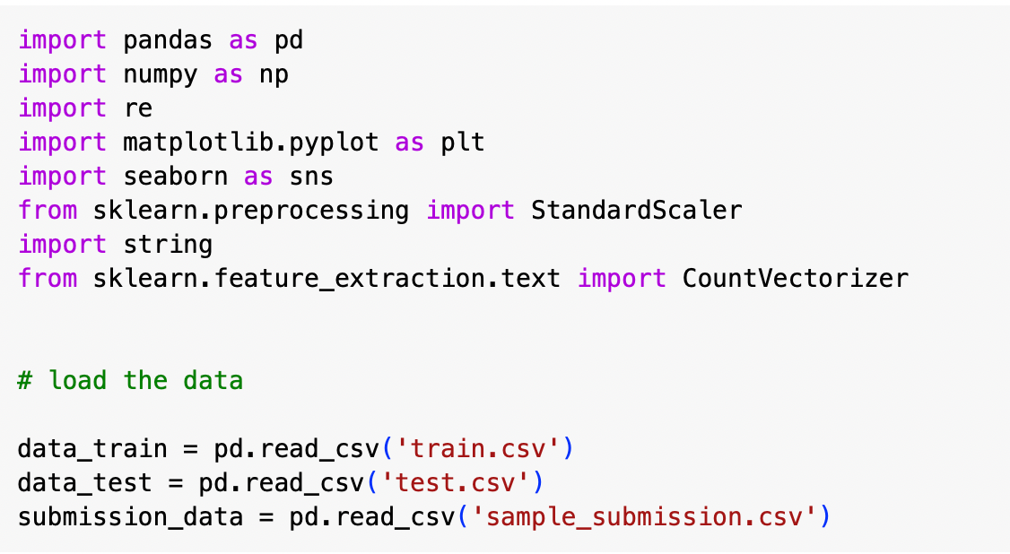

Data Collection
01
In this phase, we loaded the datasets into a Pandas data-frame

Slide 6
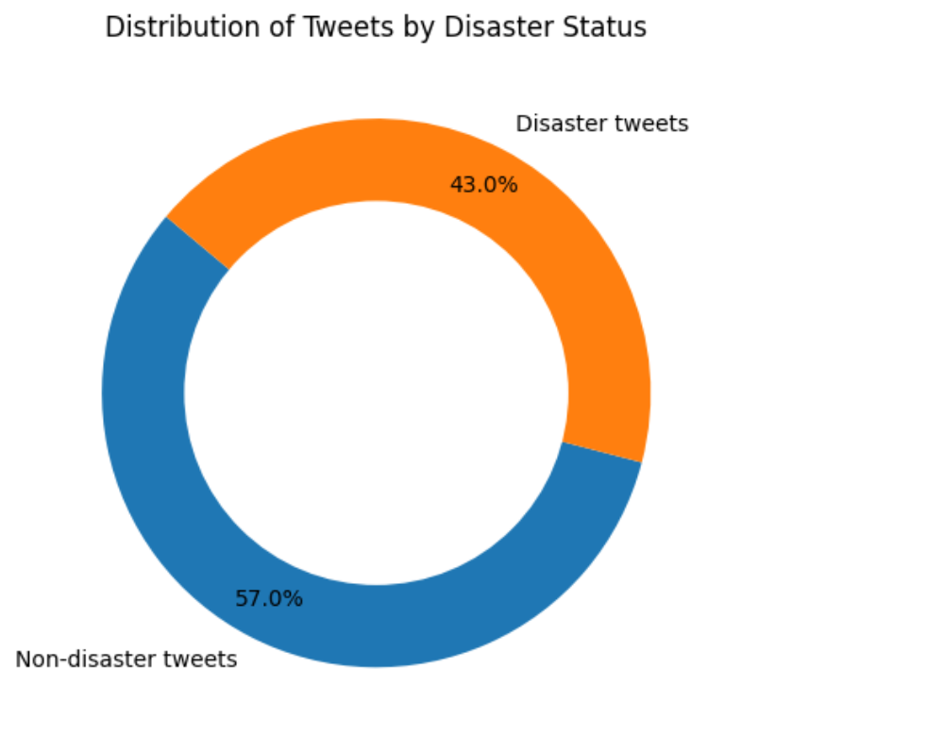
Exploratory Data Analysis(EDA)
02
Performed EDA on datasets and visualized disaster status, stop words, NaN data, Target Distribution

Slide 7
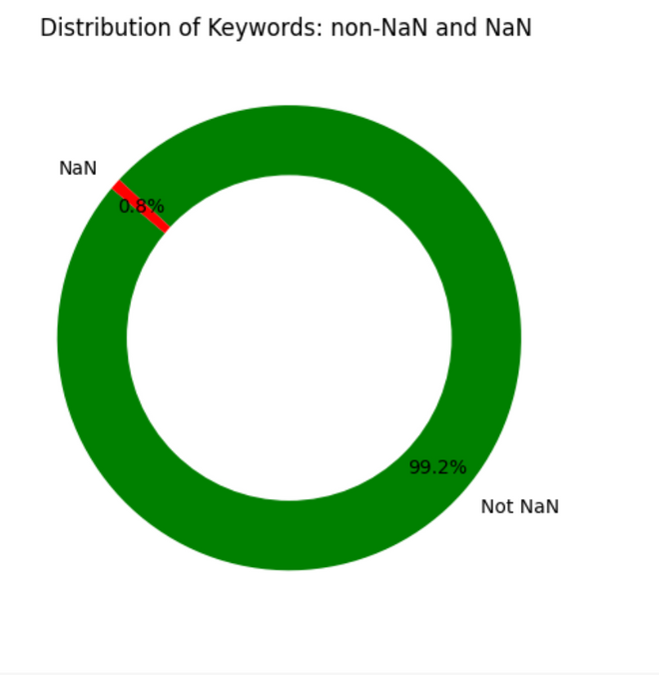
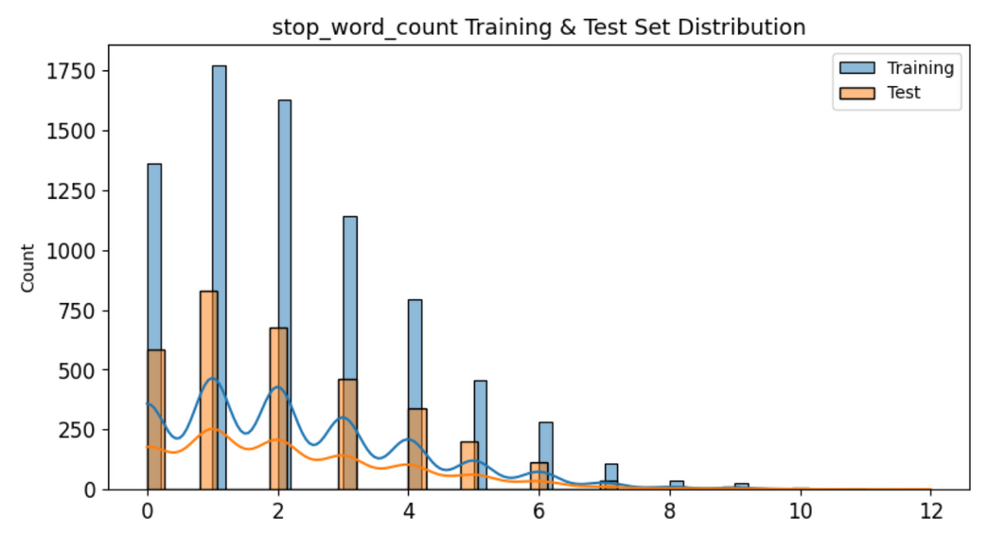
Exploratory Data Analysis(EDA)
03

Slide 8
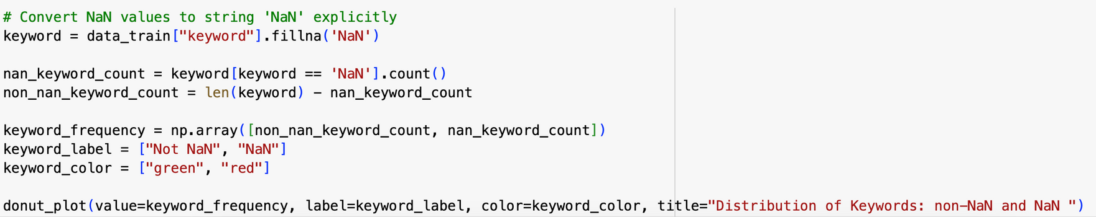
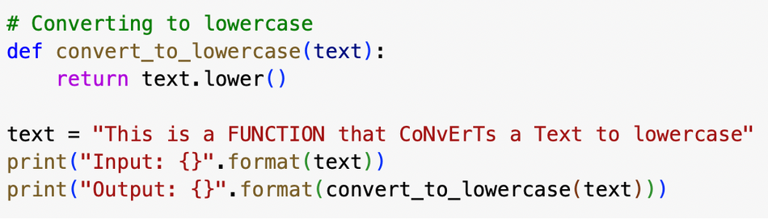
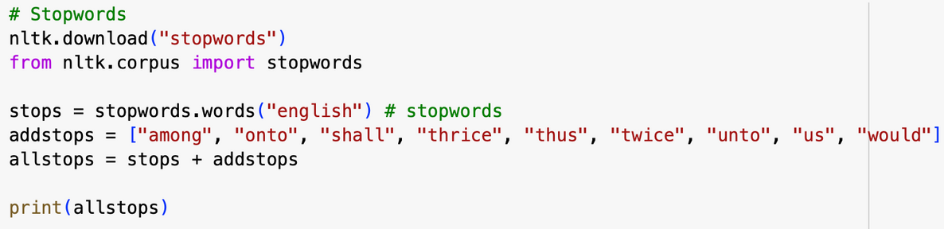
Data Preprocessing
04
In this phase, we get rid of stop words, normalizing to lowercase, handle missing data

Slide 9
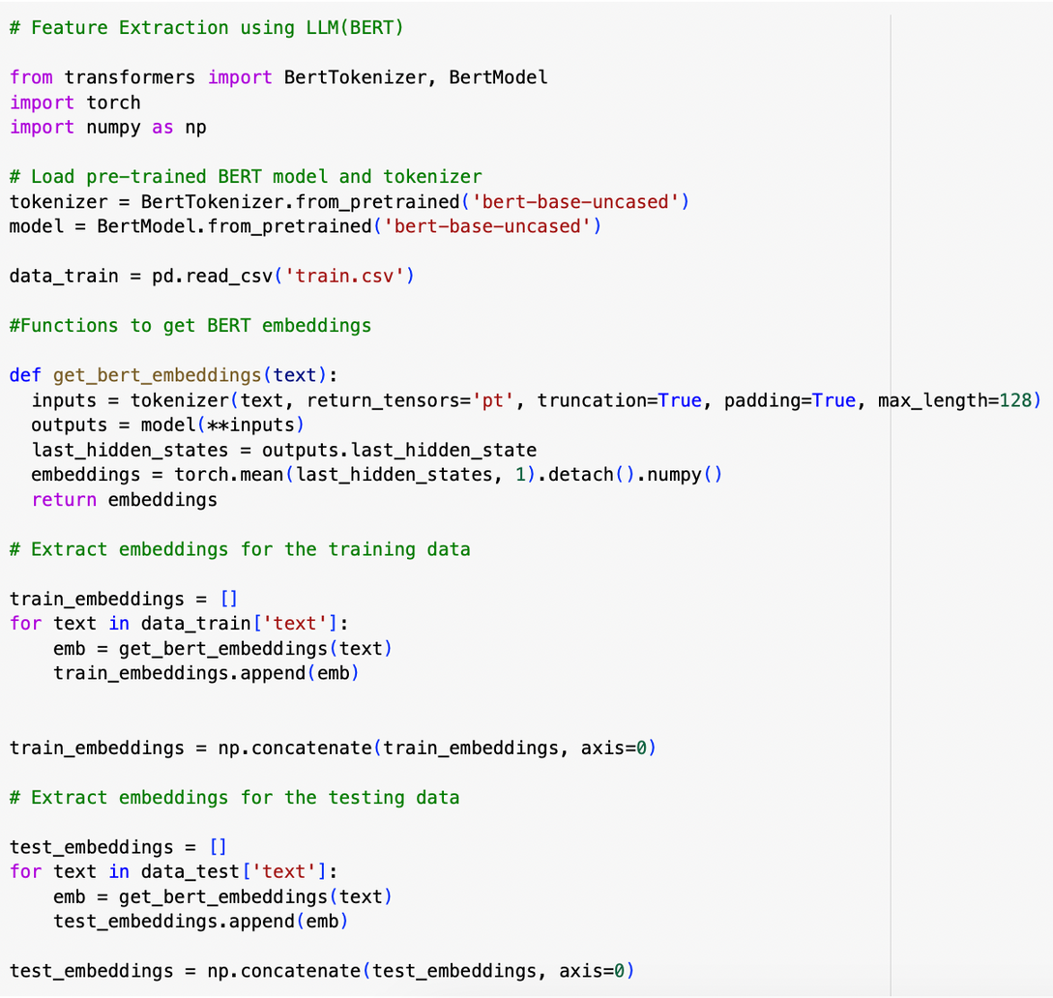
Feature Extraction
05
Using BERT model, generated rich embeddings that captured the contextual meaning of tweets

Slide 10
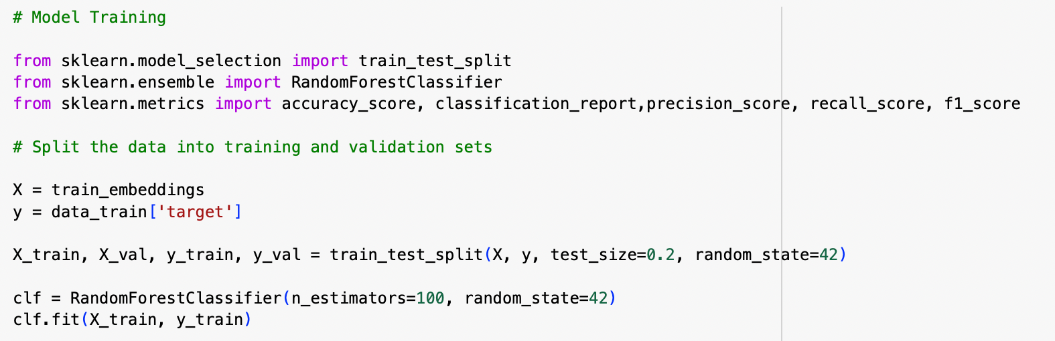
Model Training
06
Fine-tuning a pre-trained BERT model to classify tweets into categories (e.g., disaster-related or not disaster-related)

Slide 11
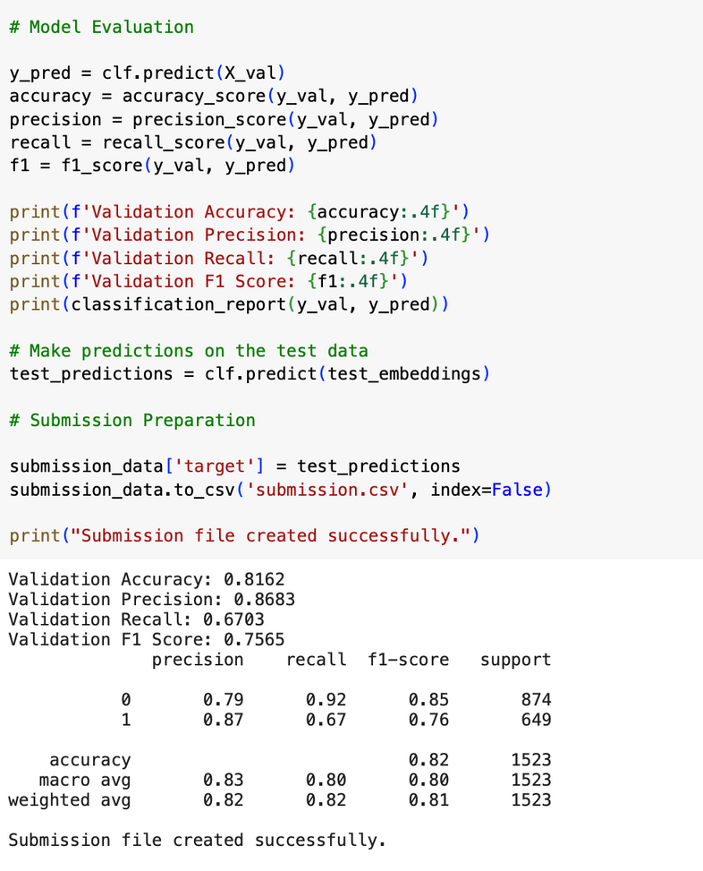
Model Evaluation
07
Fine-tuning a pre-trained BERT model to classify tweets into categories (e.g., disaster-related or not disaster-related)

Slide 12
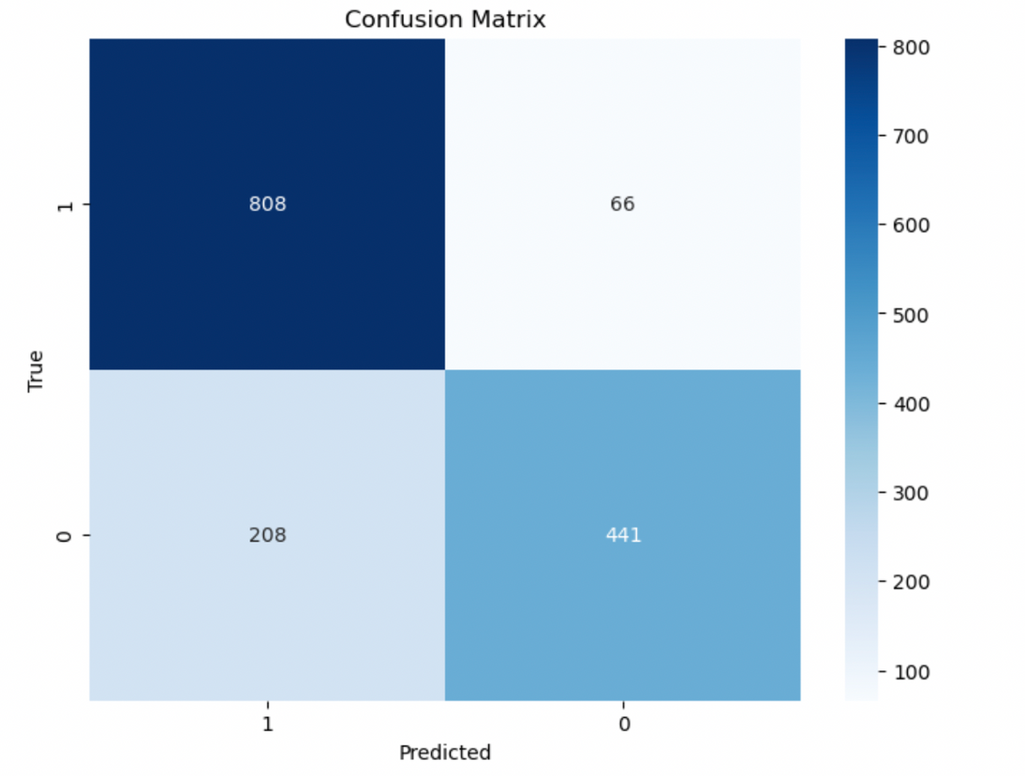
Confusion Matrix
08
Fine-tuning a pre-trained BERT model to classify tweets into categories (e.g., disaster-related or not disaster-related)
True Positive - 808
The model correctly identified 808 tweets as disaster-related when they actually are
False Negative - 66
The model misclassified 66 disaster-related tweets as non-disaster-related
False Positive - 208
The model incorrectly identified 208 non-disaster tweets as disaster-related
True Negative - 441
The model correctly identified 441 tweets as non-disaster-related

Slide 13

THANKYOU!

